Slide 1
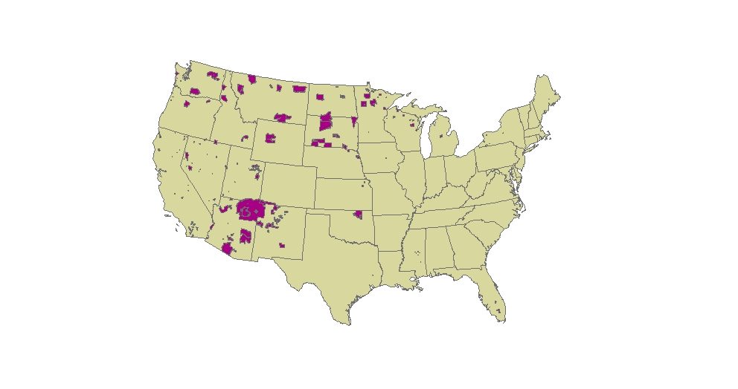
Distribution and Isolation of Native American Reservations in the contiguous U.S.
Noelle Robinson

Slide 2
Research questions:
What is the distribution of Native American Reservations in the
contiguous U.S.?
Are Native American Reservations spatially isolated from
state capitals and centers of population?
Do these spatial relationships vary from state to state?
Project rationale:
Spatial isolation could play a part in socioeconomic factors, or,
if there is no spatial pattern of isolation, this is not a factor.

Slide 3



Data
National Atlas of the United States
Indian Lands of the United States - shapefile
U.S. Census Bureau
Tribal Census Tracts – TIGER/Line Shapefile
U.S. Census Bureau
Census Urban Area National – TIGER/Line Shapefile
Price/ESRI
U.S. States (Generalized)
ArcGIS Online/A. Robinson
U.S. Capitals layer package

Slide 4
Methods
Reservation dataset
Selected By Attribute among the reservation polygons in the National Atlas file
[ADMINISTRATION] = ‘BIA’
Included 4 tract polygons listed as Open Water feature, on Bad River Indian Reservation in Northern Wisconsin
491 Census-derived tract polygons selected
Alaska excluded – different system of Native American land ownership,
only one BIA reservation, would throw off mean centers in lower 48
This dataset had an undefined coordinate system
Defined coordinate system – GCS NAD 1983 (was in dec. degrees)
Selected by Attribute for state name in order to create separate layers for each state’s Reservations. Overlapping reservations counted for each state they fall in.
Projected each layer in North American Equidistant Conic – for working with distances

Slide 5
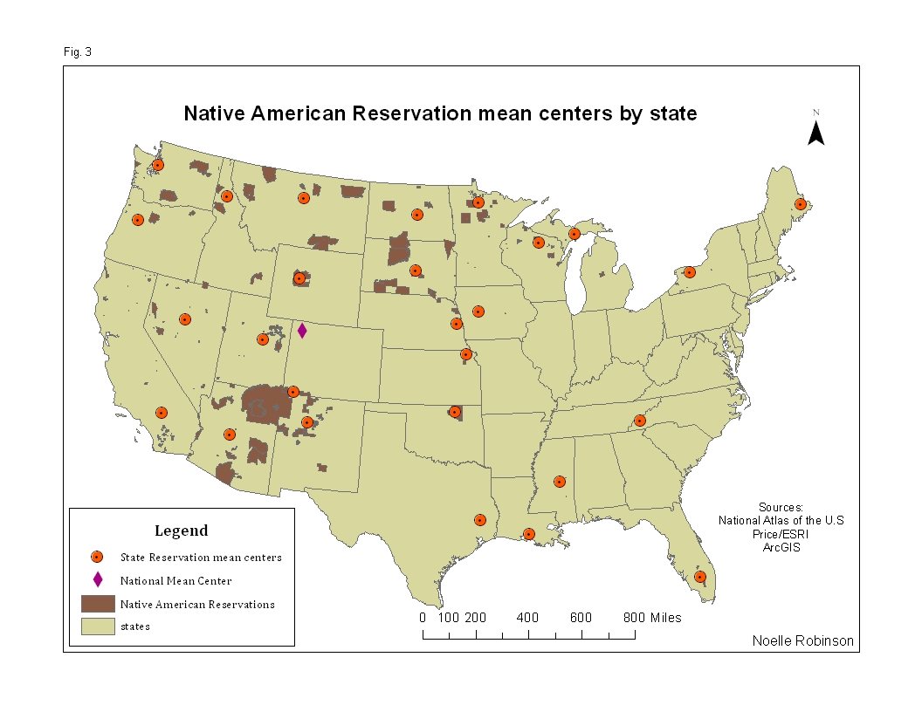
Mean center tool for each state reservation feature class
27 States have reservations

Slide 6
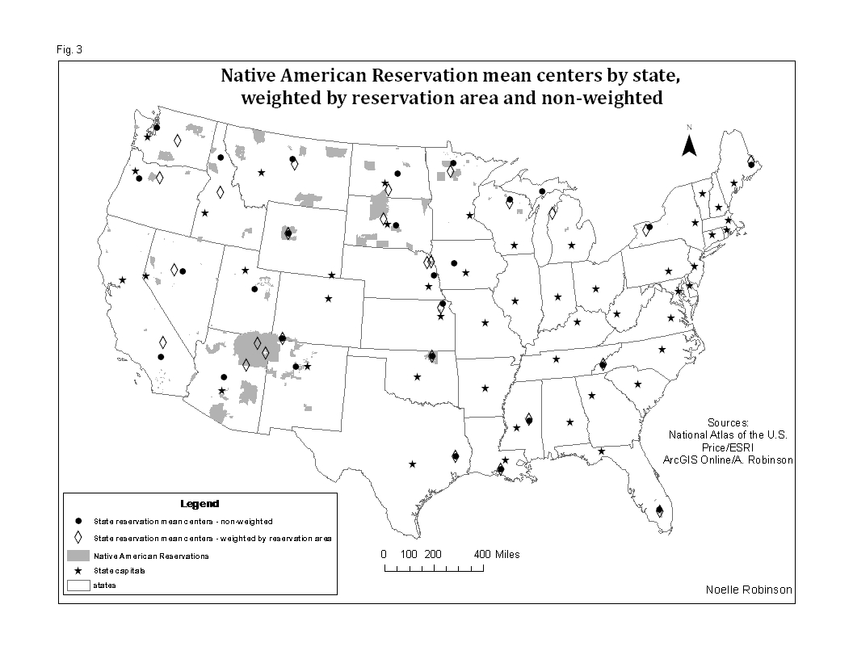
Mean center weighted by polygon area

Slide 7
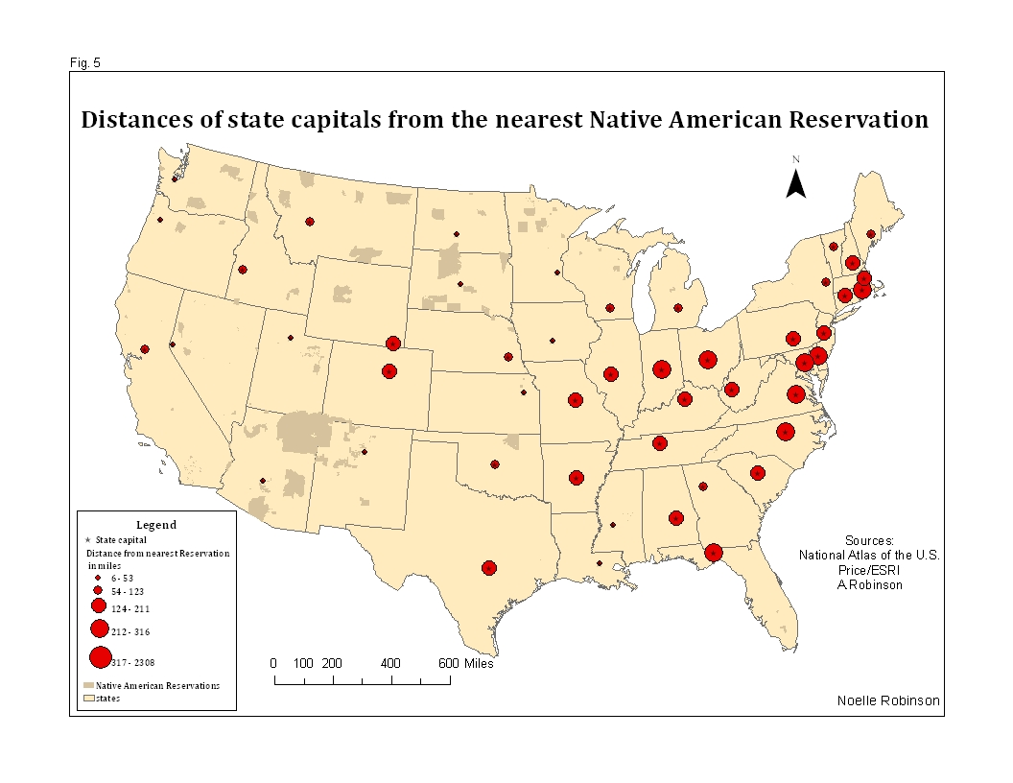
Simple distance join – reservations to capitals

Slide 8
Methods – cont’d
Urban Areas feature class
Selected by attribute for “urban area” in name
Data was for urban clusters (2,500-50,000) and
Urban areas (50,000 or more)
Created new feature class for the larger urban areas to compare distances
Selected by Location – reservations within 50, 25, 10 and 1 mile of urban places (2,500 – 50,000)
Created feature class
Selected by Location - reservations within 50, 25, 10, and 1 mile of urban areas (50,000 or more)
Created feature class

Slide 9
Proximity of Native American Reservations
to urban areas of at least 2,500 (urban clusters)

Slide 10
Proximity of Native American Reservations
to Urban Areas of 50,000 or more
Sources:
National Atlas of the U.S.
Price/ESRI
U.S. Census Bureau
Notes:
300 within 50 mi. of an Urban Area (50,000 people or more)
240 within 25 mi.
166 within 10 mi.
69 within 1 mi.

Slide 11
The most isolated reservations
in the contiguous U.S.?
(From an urban cluster)
Notes:
Duck Valley Indian Reservation – NV- ID approx. 424 sq.mi.

Slide 12
Notes:
Yomba Indian Reservation- central NV 4 tracts (polygons) 1.5, 1.9, 2.8, 0.6 sq.mi. (ranging just over ½ sq mi. to just under 3)

Slide 13
Notes:
Grand Portage Indian Reservation – NE corner MN approx. 59 sq. mi

Slide 14
Results:
Western clustering – nearest neighbor ratio 0.4 (clustered)
Spatial autocorrelation by polygon area
Moran’s Index 0.04 (near random)
Generally, reservations are more isolated from state capitals in the eastern U.S.
Relationships vary state to state
Most reservations are closer to smaller urban clusters than
to larger urban areas. Many reservations are within 1 mile of
an urban cluster but not within 50 miles of an urban area.

Slide 15
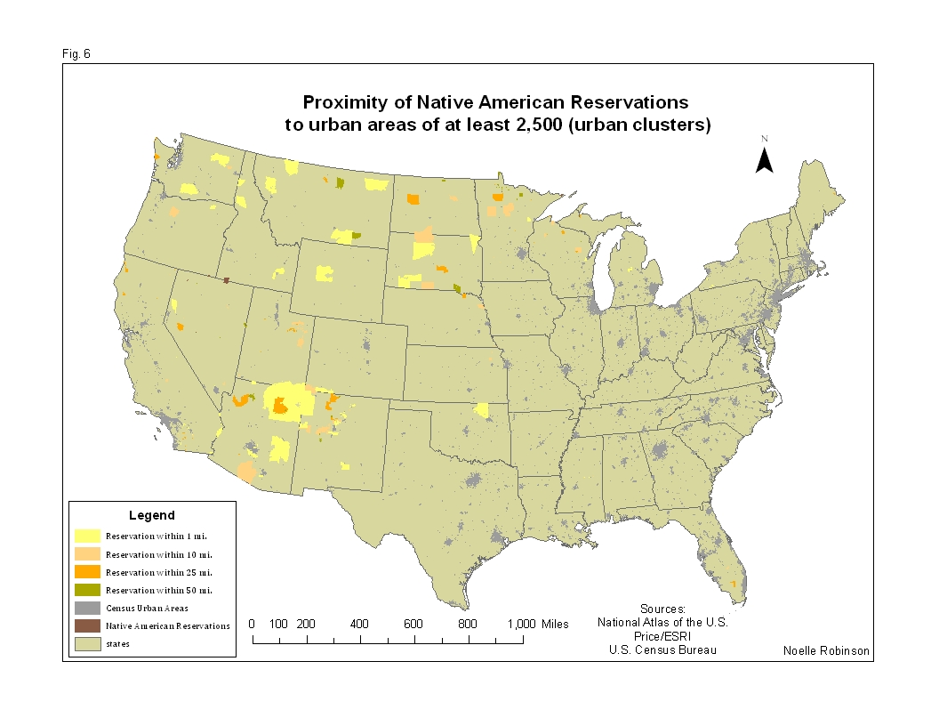

Slide 16
